Slide 1



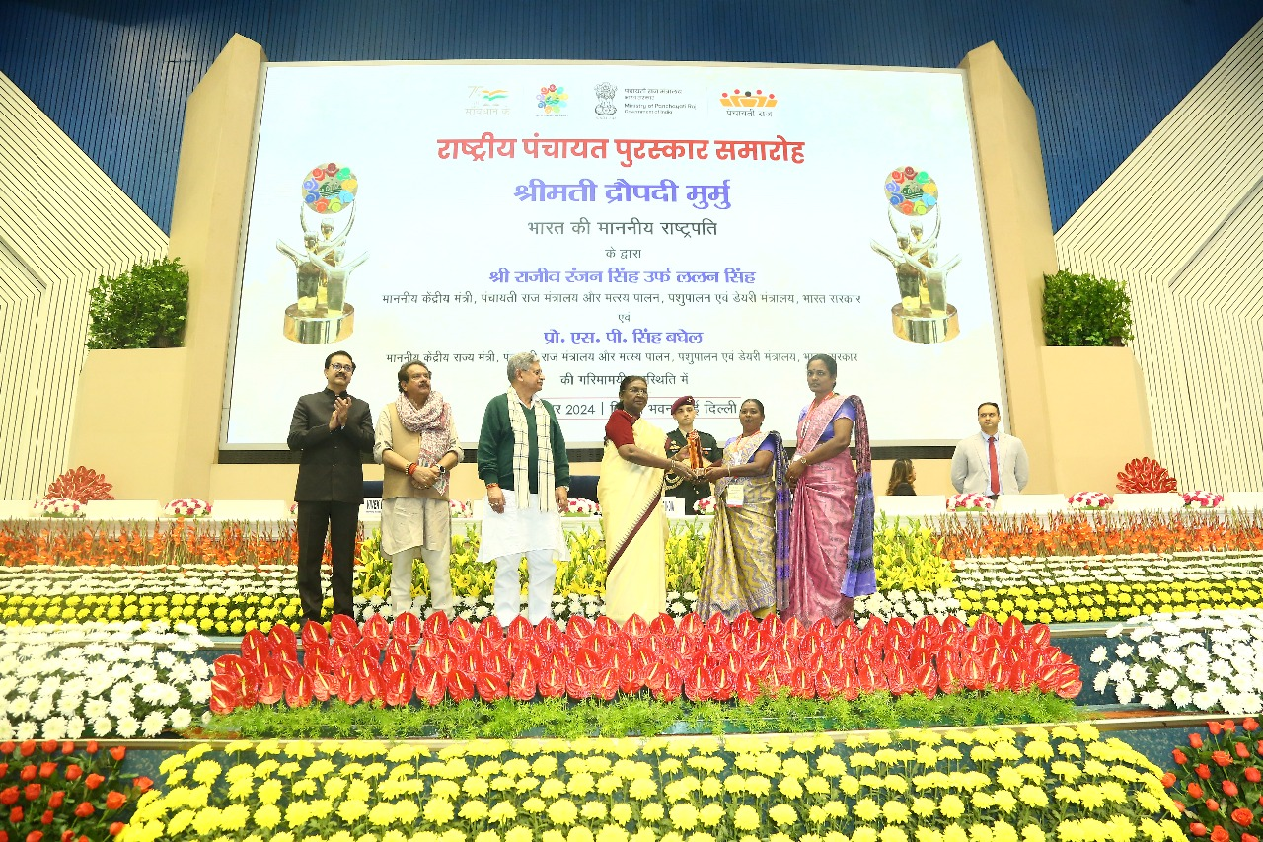
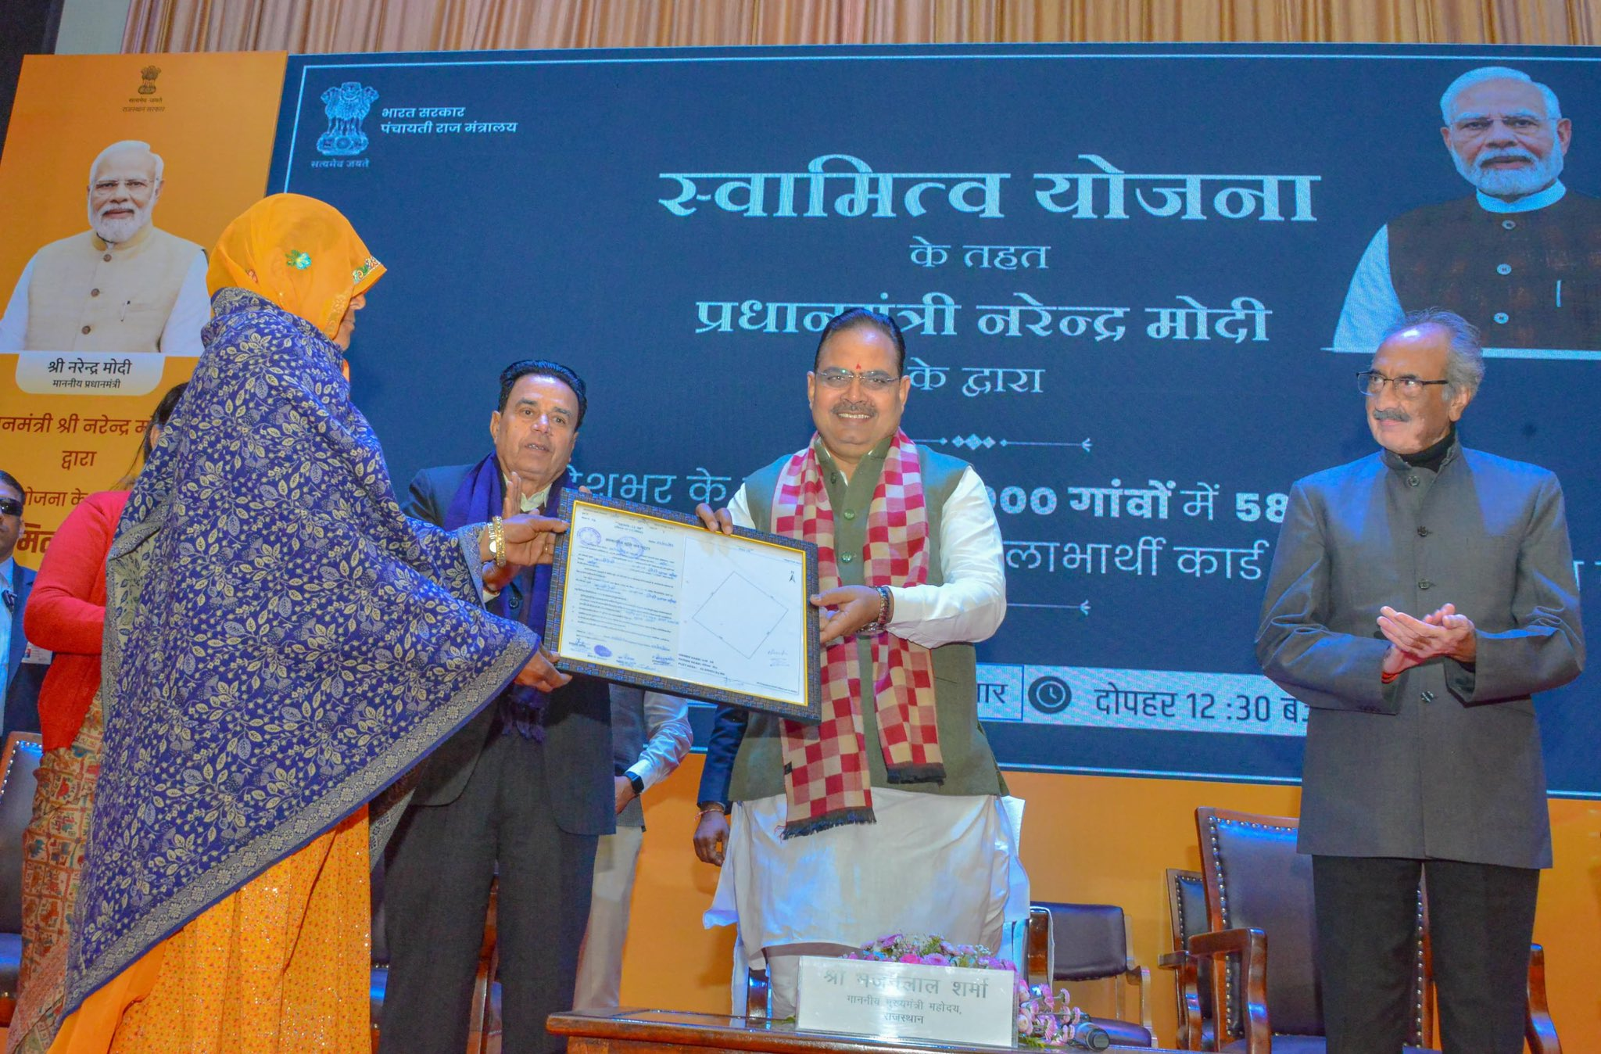
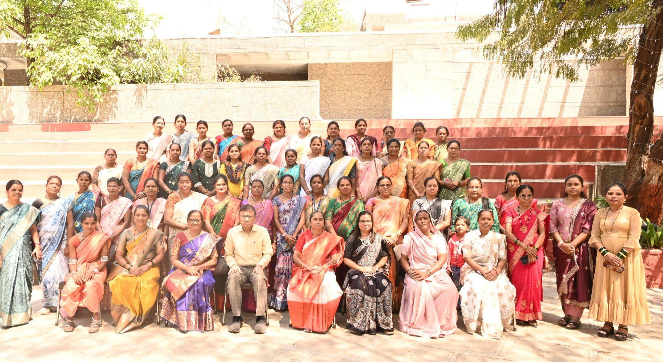
National Consultation on Gender Budgeting
Initiatives to strengthen and advance Gender Budgeting
- Sharing of Lessons by Central Ministries/Departments-
Ministry of Panchayati Raj
Government of India
19th June, 2025

Slide 2
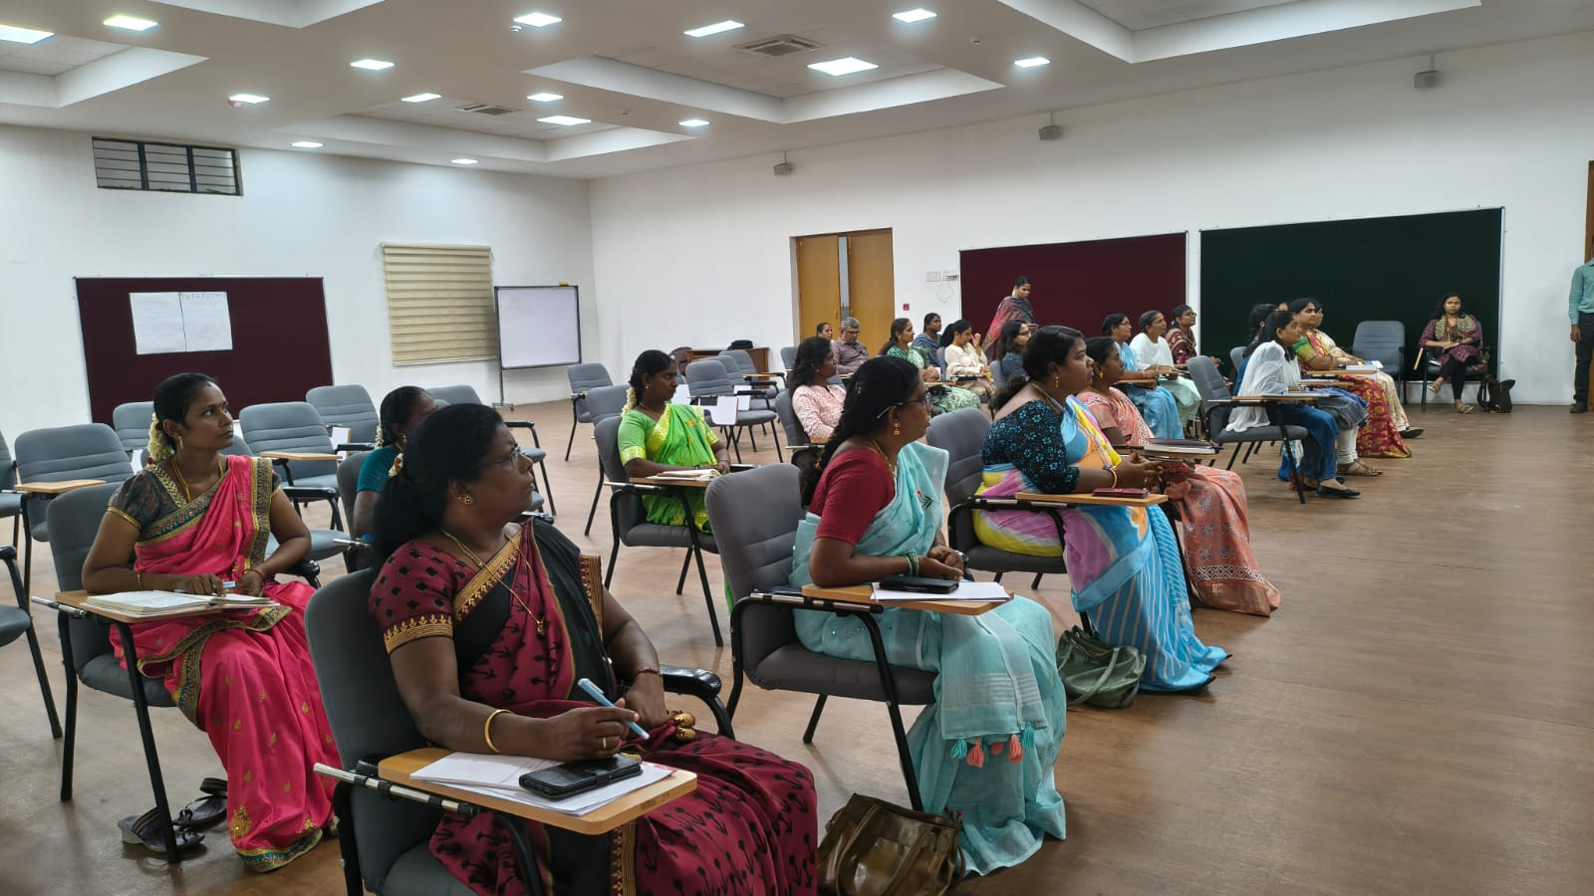
Overview of the Schemes/programmes benefitting Women : 1/2
Rashtriya Gram Swaraj Abhiyan (RGSA)
Centrally Sponsored Scheme implemented from 2018-19 (revamped w.e.f 2022-23)
Primary Objective: Strengthening of Panchayati Raj Institutions (PRIs) for achieving Sustainable Development Goals (SDGs) at grassroots level
BE Allocation in FY 2025-26 is Rs. 986.47 Crores for Capacity Building and Training (CB&T), Rs. 47.00 Crores for Incentivization of Panchayats (IoP) and Rs. 10.00 crore for Action Research and Publicity (AR&P) - all three are sub-components of RGSA
Specific actions :
Empowerment through capacity building
Inclusivepanchayats
Gender Equality: capacity building interventions, training programs, study materials
Women’s participation : Gram Sabha, Mahila Sabha, GPDP formulation
Enhanced Service Delivery : healthcare, education and sanitation
Inclusive Governance: Women friendly panchayats
2

Slide 3
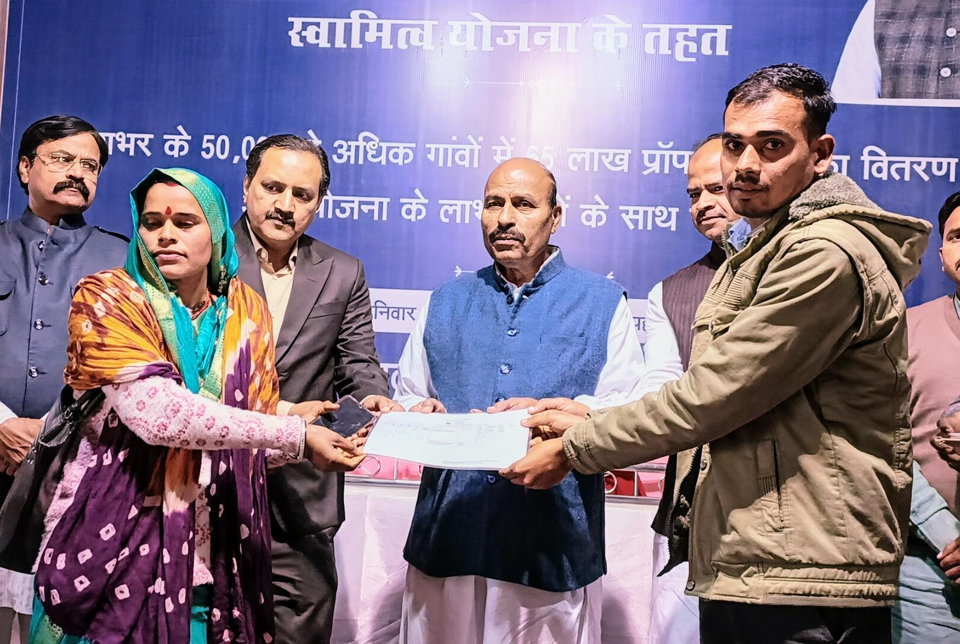
Overview of the Schemes/programmes benefitting Women : 2/2
SVAMITVA Scheme (Survey of Villages and Mapping with Improvised Technology in Village Areas)
Central Sector Scheme provides ‘Record of Property Rights’ to residents of rural populated areas (Property Card/Title Deed) through mapping land parcels using drone technology
Objectives: facilitating monetization of rural residential properties for loans / other financial benefits, reduction in property related disputes, co-ownership of women in property rights and better village level planning through digital maps.
BE Allocation in FY 2025-26 is Rs. 70.00 crores
Specific actions :
Increased Decision Making
Improved Access to Government Schemes
Better Financial Inclusion
Enhanced Property Rights
3

Slide 4
Allocations reported in the Gender Budget Statement in FY 2025-26
SI. No. | Name of the Scheme | Total BE 2025-26 ( Rs. in cr.) | Allocation in GBS 2025-26 ( Rs. crore ) |  |  |  | % of total BE reported in GBS
 |  |  | Part A > 70 % | Part B Atleast 30 % | Part C < 30 % | Total
1 (i) | RGSA – Capacity Building & Training | 986.47 | - | 345.00 | - | 345.00 | 34.97%
1 (ii) | RGSA – Action Research & Publicity | 10.00 | - | 3.00 | - | 3.00 | 30%
1 (iii) | RGSA –Incentivisation of Panchayats | 47.00 | - | - | 2.55 | 2.55 | 5.42%
2 | SVAMITVA | 70.00 | - | 21.00 | - | 21.00 | 30%
4

Slide 5
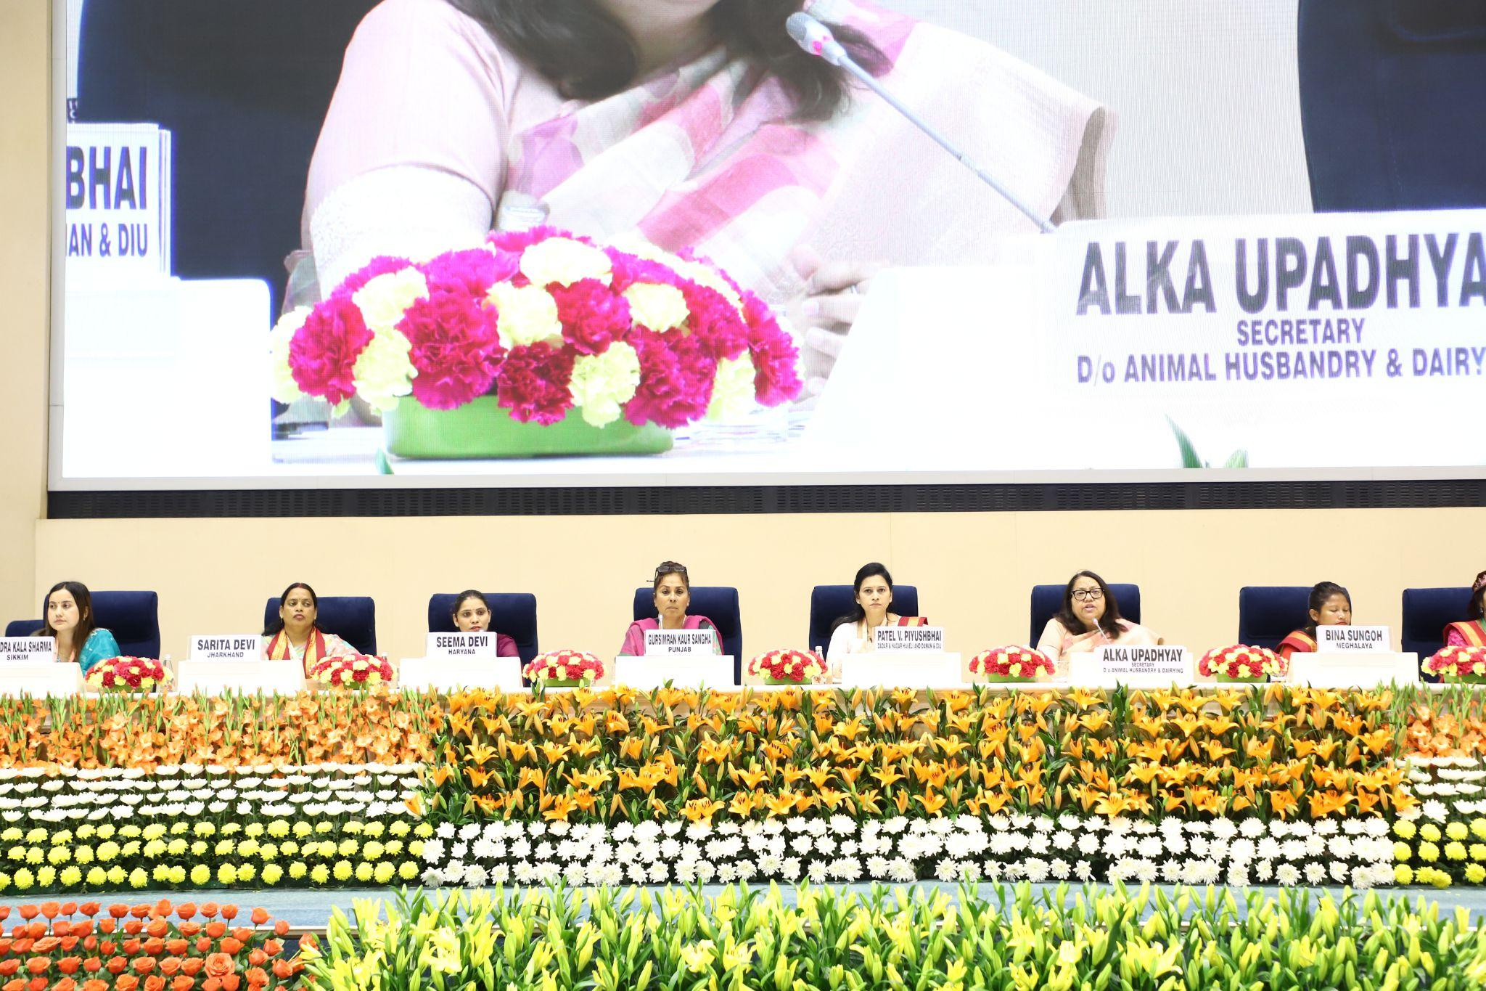
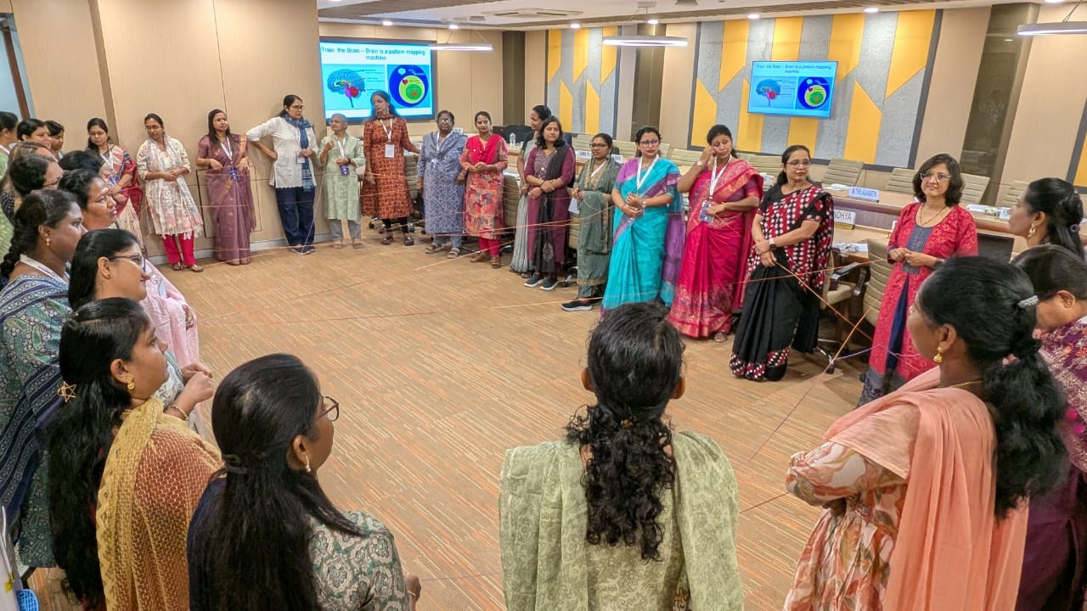
Initiatives for Strengthening Gender Budgeting
RGSA- mandatory induction training within 6 months of election & refresher training within a year of election of all Election Representatives (ERs) including EWRs.
Year | Total Trained | WER & Women Functionaries | %
2022-23 | 4205240 | 2,236,474 | 53.18
2023-24 | 3992382 | 2,296,119 | 57.51
2024-25 | 3554942 | 1,986,912 | 55.89
सशक्त पंचायत-नेत्री अभियान (Empowered Women Panchayat-Leader) Campaign
around 1200 Women Elected Representatives (WERs) of Panchayats attended;
24 WERs as Beacon leaders felicitated for exemplary works in rural governance.
Comprehensive Special Training Module focusing on strengthening leadership, communication, and negotiation skills of WERs in PRIs.
A total of 193 Women Master Trainers have been trained as on date.
Management Development Programme (MDP) through IITs/IITMs/IRMA to ERs/Functionaries of PRIs. 8 MDP held since January 2024; 189 participants trained, 107 are women.
Contd…
5

Slide 6
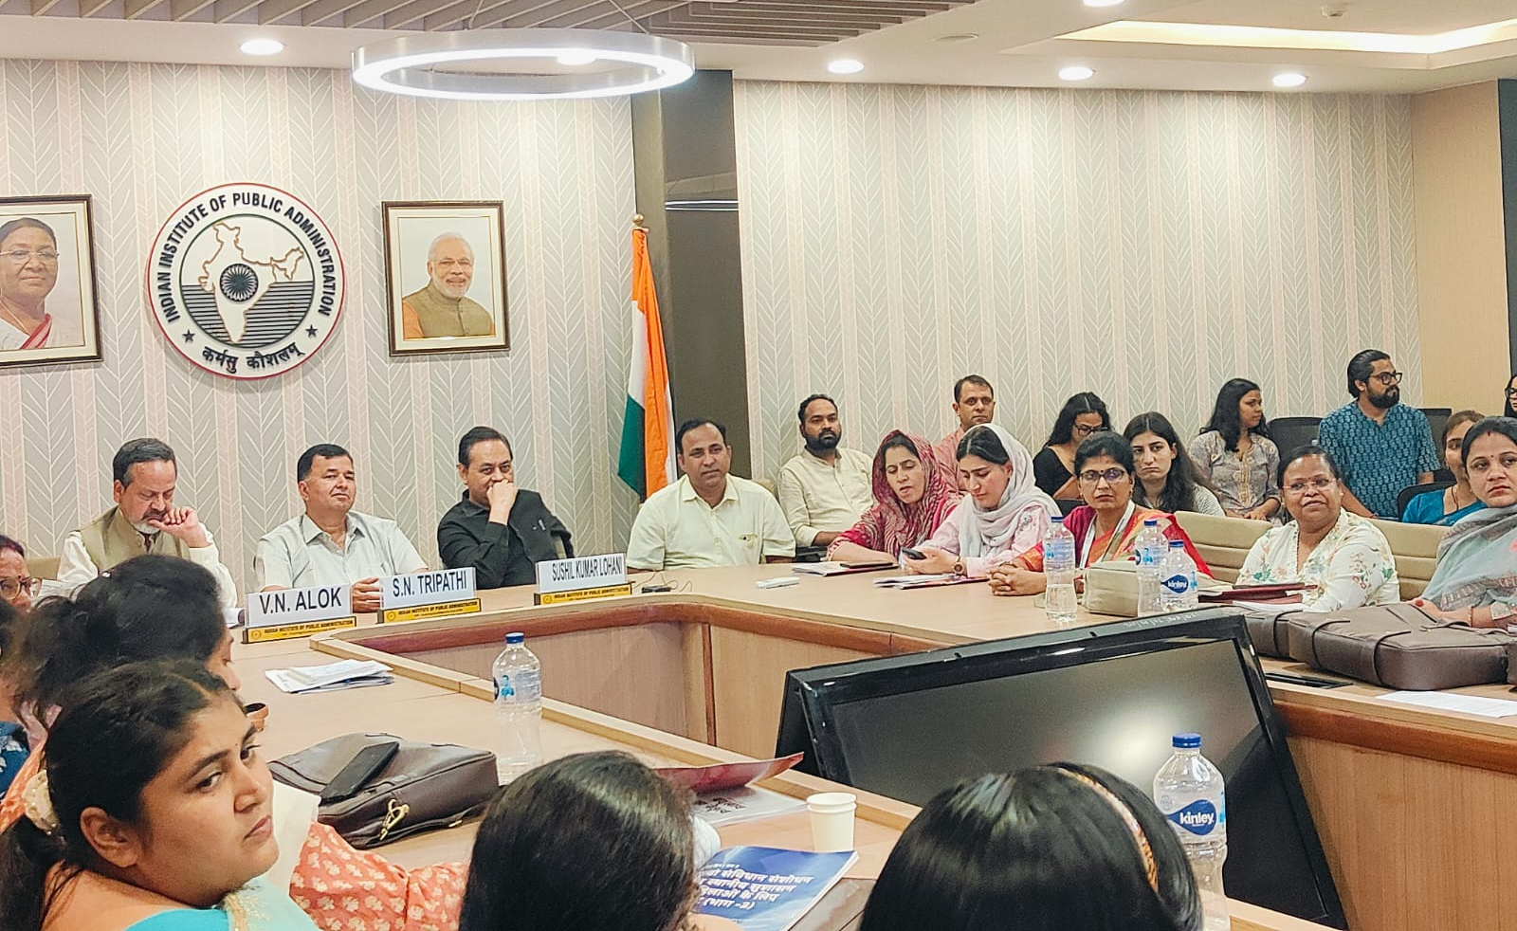
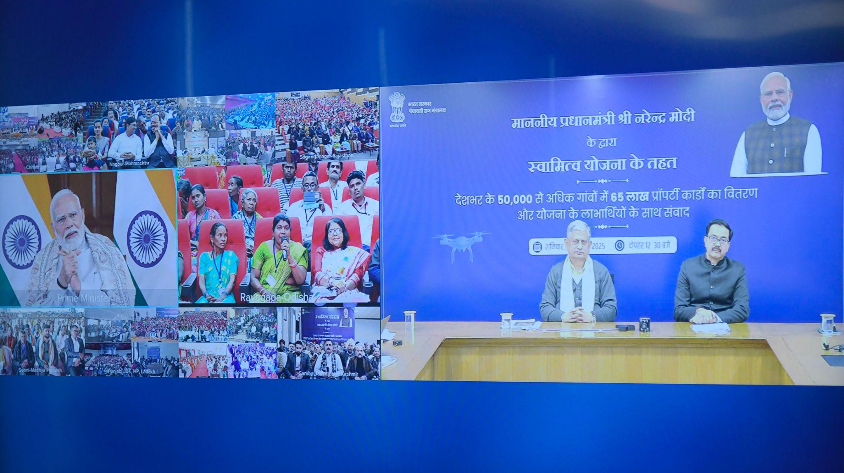
Initiatives for Strengthening Gender Budgeting
Output-Outcome Monitoring Framework:
Under the capacity building component of RGSA, an output indicator 1.2 : “Number of elected women representatives trained in current year” has been added in OOMF 2025-26
Gender Budgeting Cell
Co-ownership of Property under SVAMITVA Scheme: covers both men & women. States like Madhya Pradesh, Haryana, Karnataka, Chhattisgarh, Mizoram, J&K, Puducherry, Daman & Diu etc have provisioned for co-ownership of women in property rights
6

Slide 7
Way Forward
Introduce gender budgeting as a measurable indicator within the Women-Friendly Panchayat theme of LSDGs for the National Panchayat Awards.
Promote the spirit of gender budgeting in Inter-Ministerial Convergence and Collaborative Schemes such as TB Mukt Panchayat, Rabies and Snakebite Preventions, One Health etc of M/o Health & Family Welfare.
Create a national repository of best practices, case studies, and gender budgeting innovations in PRIs.
7

Slide 8
THANK YOU

