Slide 1
National Consultation on Gender Budgeting with Central Ministries/Departments and State Governments
Organized by
Ministry of Women & Child Development
19 June 2025
Hall No 2 & 3: Vigyan Bhawan, New Delhi
Initiatives to strengthen and advance Gender Budgeting
– Sharing of lessons by the State Government
Presented by:
Finance &
Women and Child Development,
Government of Assam

Slide 2
GB Institutional Mechanism in the State
Key Initiatives | Inputs
(i) Year of adoption of Gender Budgeting by the State | 2012-2013
(ii) Budget circular includes GBS instructions | 2012-2012
(iii) Nodal Department for GB | Finance
(iv) Focal Department for GB (if any) | WCD
(v) Formation of Gender Budget Cells in State Departments | 2023-24
(vi) Designated Nodal officer for GB in each Department | 41 departments
(vii) Formation of Inter-Departmental Committee on GB | No
(viii) Gender Budget Statement Published (since when) | 2018-19
(ix) State Action Plan on GB | 2023-24
(x) Designated nodal centre for GRB trainings | Assam Administrative Staff College Hub for empowermwnt of women, WCD Dept.
Notes:
In the FY 2012-13,m Gender Budget was introduced but the Gender Budget Statement was published since 2017-18

Slide 3
Trends in Allocations reported in the Gender Budget Statement during last 3 years
Year | Total BE of all Schemes (Rs. Lakh) | Total BE of GBS Allocation of all schemes (Rs. Lakh) | % of total BE reported in GBS | Total No. of Schemes reported in GBS
2025-26 | ₹15598514.55 | ₹1850752.40 | 11.86% | 292
2024-25 | ₹16867270.44 | ₹988624.58 | 5.86% | 228
2023-24 | ₹16996613.02 | ₹1081626.2 | 6.36% | 168
Source: FinAssam
Notes:
All the data are taken as per FinAssam revised data. The above table shows an increasing trend of GB shared compared to the last three FY. The number of reported schemes has also increased. Although there is slight decline in 2024-25 but there is a sharp increase in 2025-25. It is to be noted that although there is a decline in the total state budget but there is an increase of GB %

Slide 4
Overview of the Schemes/Programmes benefitting women and girls
Scheme | Objective of the scheme | Type of Scheme | Department | Total Budget (in lakh) | % of Allocation | Amount for women empowerment (in lakh)
Mukhya Mantri Mahila Udyamita Abhiyaan (MMUA) (Flagship Scheme) | This scheme will provide entrepreneurship find for SHGs members | SOPD | PNRD | ₹ 303800 | 100% | ₹ 303800
Mukhya Mantrir Nijut Moina (Flagship Scheme) | Boosting girls education and reducing girls school dop outs | SOPD | Education | ₹ 39100 | 100% | ₹ 39100
Welfare Of Transgender Community (HIJRA) | Funds for development of transgender home | SOPD | Social Justice and Empowerment | ₹ 75 | 100% | ₹ 75
Subsidy to Women Cooperative Society-SOPD scheme | Subsidy to women cooperative society | SOPD | Cooperative | ₹ 205 | 100% | ₹ 205
Orunodoi (Flagship Scheme) | Rs, 1250/- PM will be provided to women and disable | SOPD | Finance | ₹ 500000 | 98% | ₹ 490000
Pradhan Mantri Matru Vandana Yojana | To improve the maternal health and nutrition | CSS | WCD | ₹8889 | 100% | ₹8889
Notes:
*The schemes list includes flagship schemes, SOPD, CSS and EE Schemes

Slide 5
Overview of the Schemes/Programmes benefitting women and girls
Scheme | Objective of the scheme | Type of Scheme | Department | Total Budget | % of Allocation | Amount for women empowerment
Scheme for protection of woman from Domestic Violence | Capacity Building program for service provider | EE | WCD | ₹42.75 | 100% | ₹42.75
Scheme for protection of women against sexual harassment at workplace | Capacity building for service providers | EE | WCD | ₹9.00 | 100% | ₹8.64
Women Helpline-181-Central | Protection and redressal mechanism for women | CSS | WCD | ₹55.2 | 100% | ₹55.2
Sakhi Niwas | safe, affordable, and conveniently located accommodation for working women and women pursuing higher education or training | CSS | WCD | ₹137.07 | 100% | ₹137.07
One Stop Crisis Centre | intended to support women affected by violence, in private and public spaces, within the family, community and at the workplace | CSS | WCD | ₹101 | 100% | ₹101
Shakti Sadan | offers a safe and enabling environment, along with various support services like shelter, food, clothing, counselling and health care for survivors of GBV and trafficking | CSS | WCD | ₹678.62 | 100% | ₹678.62
And all other schemes of WCD
Notes:
POSH and GBV schemes are for capacity building

Slide 6
State Initiatives for Strengthening Gender Budgeting Processes
  In Assam, both Finance and WCD are working in coordination and convergence to strengthen GRB in the State.
  Role of WCD:-
  Training, Orientation and Capacity Building with the line departments in the state
  Formation of the Gender Budget Cell in the line department
  Providing technical inputs on GRB in government institution including training institution
  Best Practice- GBC members in General Administrative department took active initiative in reporting of schemes under GBS and the department reported for the first time for the FY 2025-26.
  Role of Finance:
  Preparing GBS
  Strengthening the reporting of schemes through a gender lens
  Monitoring and tracking of utilisation
  Post Budget analysis
  Pre-budget consultative programs with nodal officers and departments, training of budget officers for reporting
Notes:
In 5 departments, GBCs were formed (WCD, Housing and Urban Development, Power, Tribal and Indigenous Affairs and General Administrative)

Slide 7
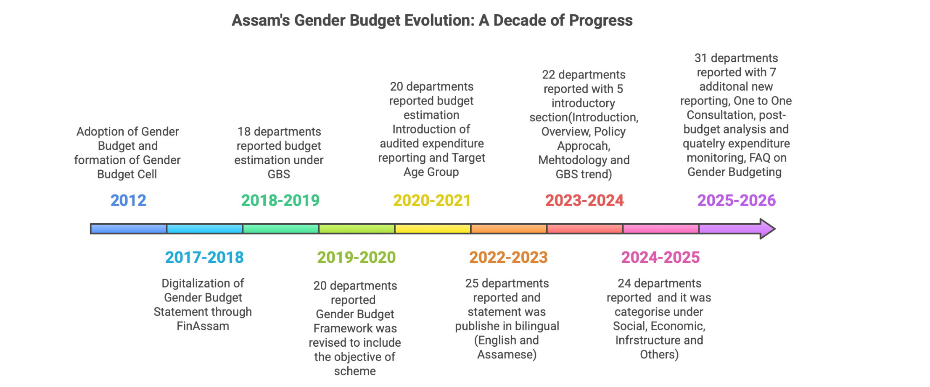
State Initiatives for strengthening Gender Budgeting Processes

Slide 8
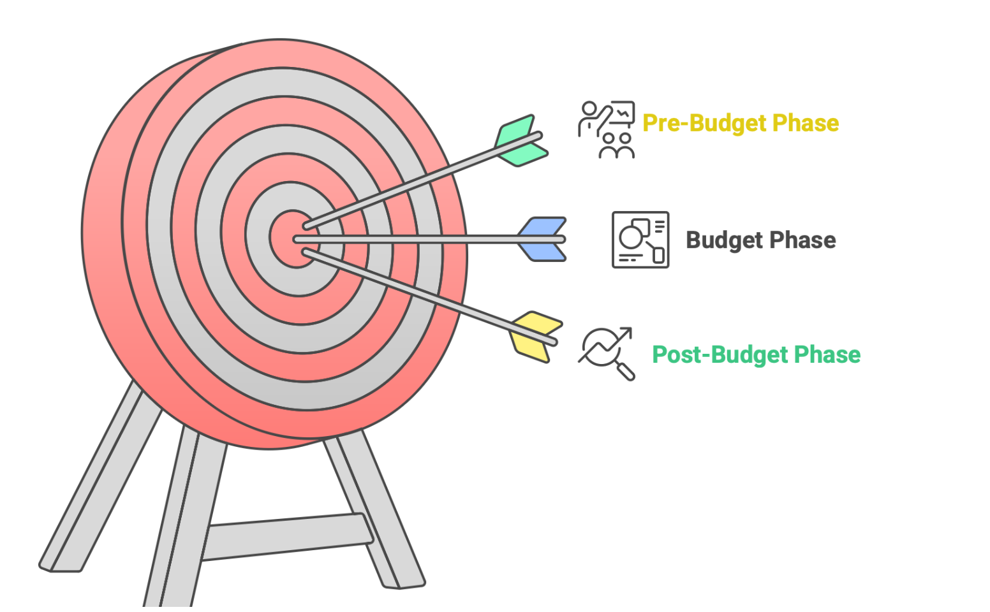
Stages of preparing Gender Budget Statement in the Assam
  Pre-Budget Phase-
    Mapping of potential departments
    Mapping of potential schemes
    One-to-one Consultation
    Training on Gender Budget for Nodal Officers
    Training on the reporting of GBS in FinAssam
  Budget phase-
  Inclusion of Gender Budget in the Budget Circulars
  Issuing SoP on Gender Budgeting to the line departments
  Follow up for timely reporting
  Validation and review of reported schemes and allocations
  Post Budget-
    Assessing the performance of the department based on KPIs (Allocation, Utilisation, PART A/PART B Allocations, GB share, Total number of reported new schemes)
    Quarterly Monitoring and Tracking of Utilisation and Expenditure (Scheme Wise)

Slide 9

State Initiatives for strengthening Gender Budgeting Processes
  Innovative Measures for Strengthening GB in the state
  Inclusive Budget Cell (IBC) headed by a Secretary, Finance department.
  Post Budget analysis : Assessments of Department Performance by KPI development-
    1.Financial indicators
    2.Notionalisation & Weightage
    3.Categorisation of the schemes
    Tracking of Expenditure: Quarterly monitoring of expenditures (Scheme wise)

Slide 10
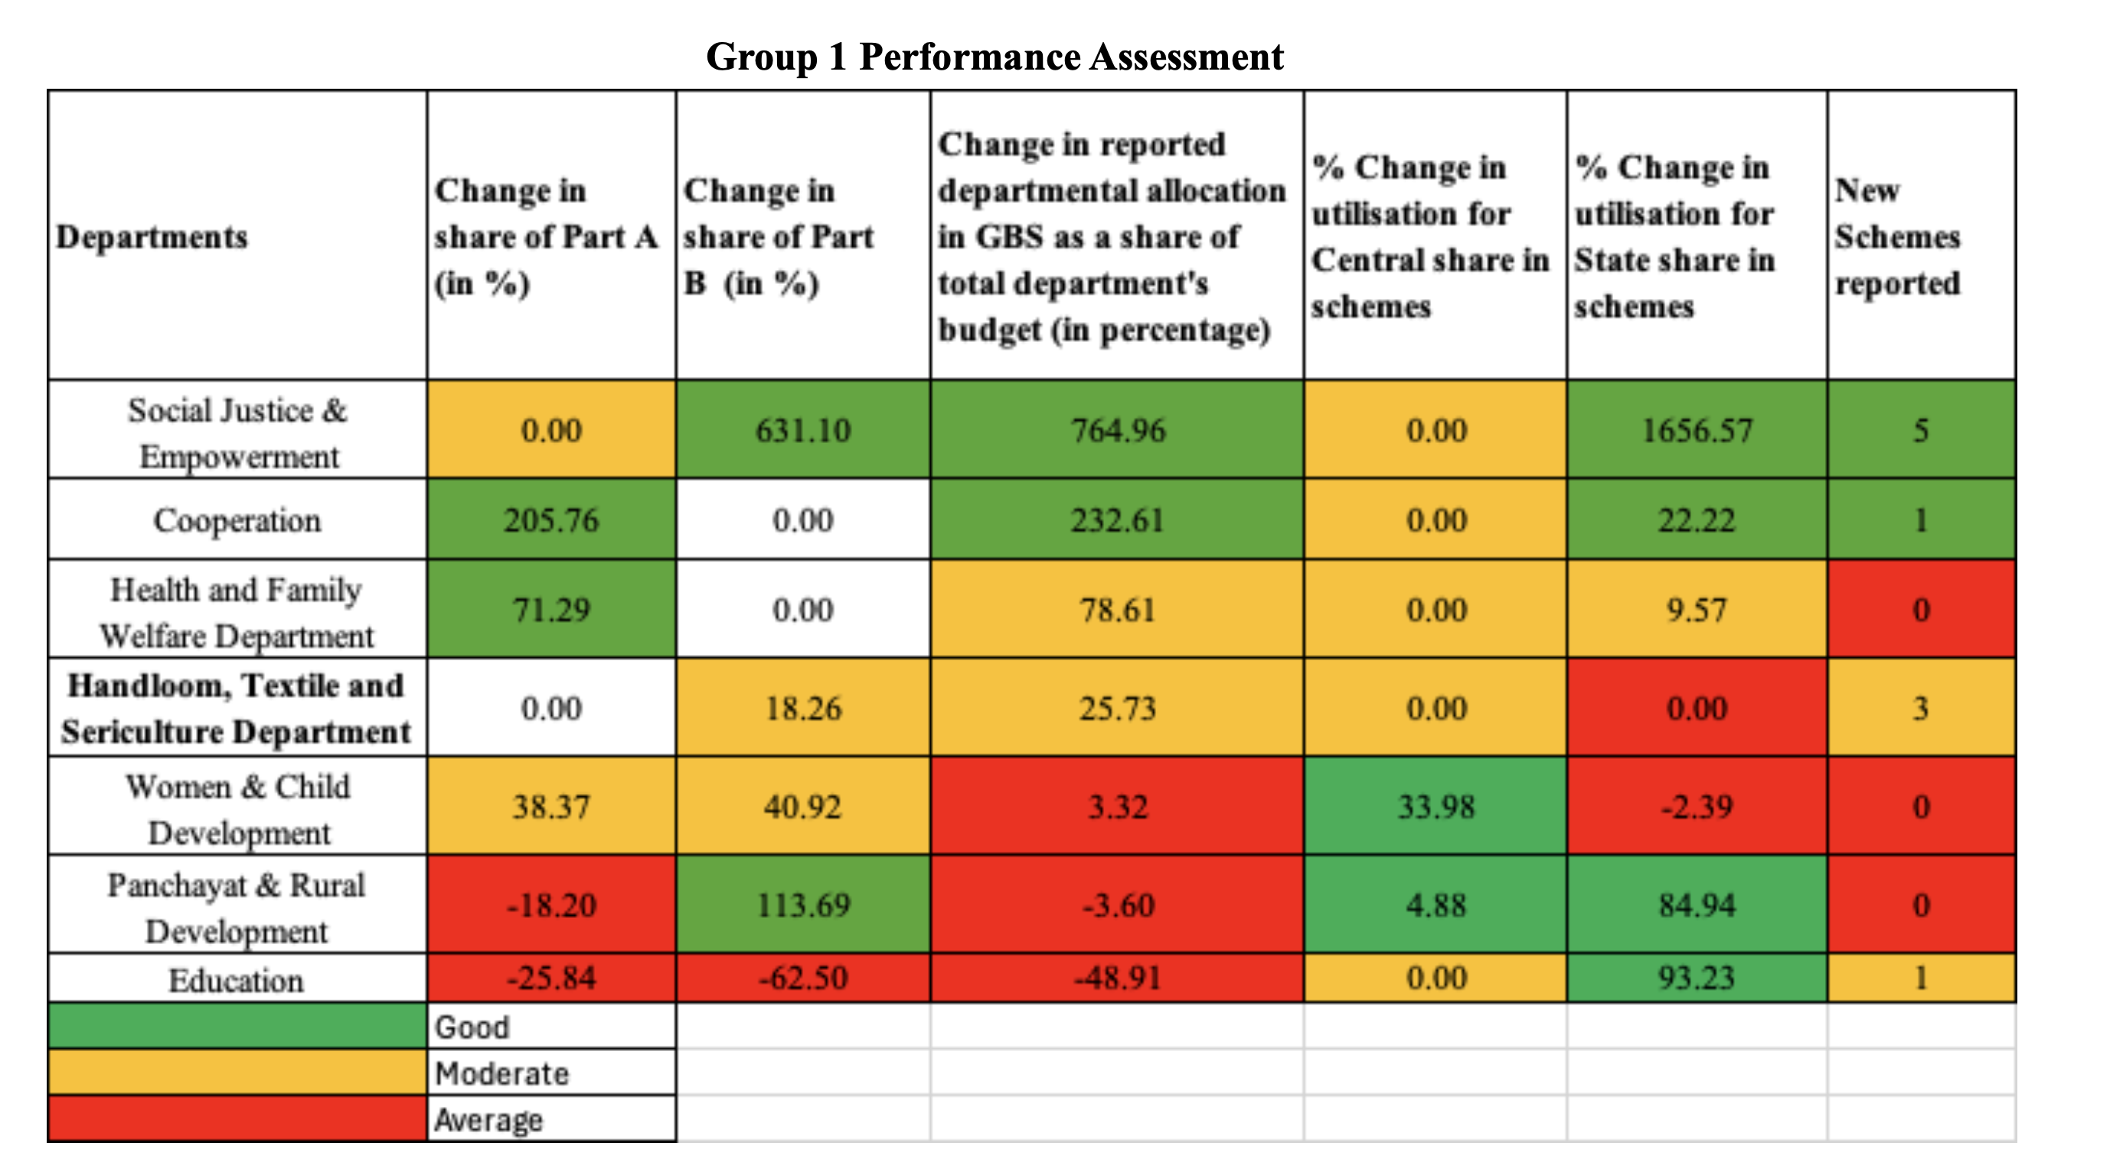
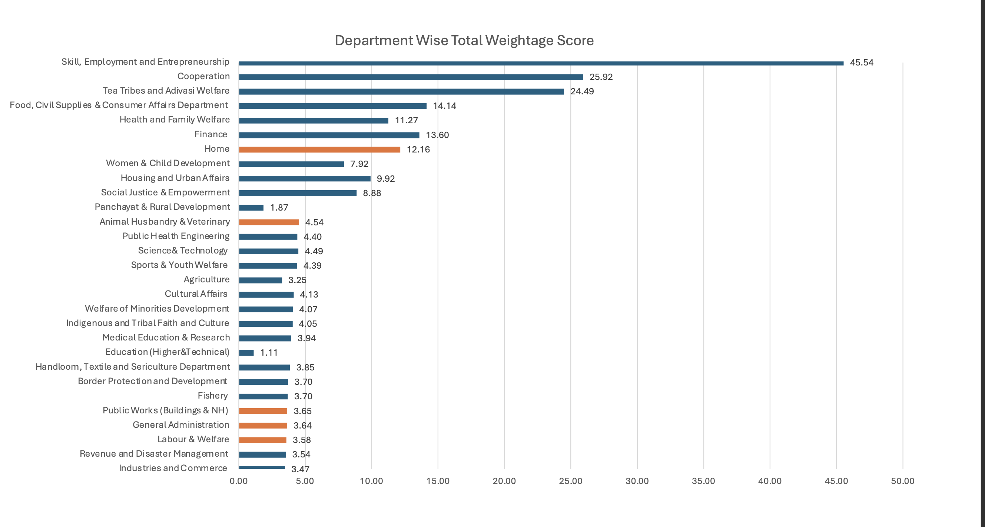
Snapshot of Scorecard report
Score card for FY 2025-26
The data are collected from FinAssam
Notes:
For the FY 2025-26, we have majorly assessed the performance of SOPD schemes and departments are scored based on the SOPD Schemes. The findings of performance assessment is shared with the departments and are also presented during training sessions.

Slide 11
State Initiatives for strengthening Gender Budgeting Processes
Methodology
Budget Estimations for Gender Empowerment
For FY 2025-26, a new column, "Budget Estimation for Gender Empowerment
This column reflects the portion of the total scheme budget allocated for women, calculated based on the percentage of actual or estimated female beneficiaries.
Budget Estimations for Beneficiary- and Non-Beneficiary-Oriented Schemes
  Beneficiary-Oriented Schemes:
  For schemes with direct beneficiaries, budget estimations are reported using gender-disaggregated data.
Non-Beneficiary-Oriented Schemes:
  For schemes without direct beneficiaries, budget estimations are based on projected female participation or usage, with appropriate justification.

Slide 12

Way Forward
  Formation of Inter-Departmental Monitoring Committee
  Formation of the Gender Budget Cell/Inclusive Budget Cell in the line departments
  Strengthening the Monitoring and tracking process
  Strengthening the gender disaggregated data in the state
  Post Budget Consultation with the line departments to discuss the findings of the post-budget performance scorecard
  State level training program for Nodal Officers on GRB
  Pre-Budget Consultation with the CSO/partner organisation and other community groups

Slide 13
Thank you!

